Slide 1
Bank Management System
Developed By
Name: Mirza Shafiur Rahman
ID: 200103020050
Name: Mirza Anjuman Ara Juman
ID: 562310005101035

Slide 2
What is a Bank Management System?
A desktop application for managing banking operations.
00
00
Developed using Java Swing for GUI and MySQL for database management.
Facilitates secure and efficient handling of customer accounts, transactions,
and data.
00

Slide 3
Motivation for a Bank Management System
Improve Efficiency: Automate manual tasks to streamline banking operations
Enhance Customer Experience: Offer faster and more accessible services
for customers.
Ensure Security: Protect sensitive financial data through robust security
measures.
Reduce Costs: Minimize errors and reduce the need for extensive staff
involvement.
Ensure Compliance: Meet legal and regulatory standards automatically.
Scalability: Adapt to growing transaction volume and user base.

Slide 4
Objectives of the System
Automate banking processes like account creation and transactions.
Provide a user-friendly graphical interface.
Ensure secure storage and retrieval of customer data.
Minimize manual errors.

Slide 5
Key Features of the System
Account Create: Sign in, Sign Up, clear
Transaction Handling: Deposit, withdraw, and fast cash.
Database Integration: Store and manage customer and transaction
details in MySQL.
Reports: Generate account and transaction summaries.

Slide 6
Workflow of the System
User logs in securely
Selects an operation (account management, transactions, or reports).
System performs the operation and updates the MySQL database.
User logs out securely.

Slide 7
Technologies and Tools
Programming Language: Java (Swing & AWT)
Database: MySQL (direct integration)
Connectivity: JDBC (Java Database Connectivity) for database
operations.

Slide 8
System Architecture
Presentation Layer: Java Swing GUI for user interaction.
Logic Layer: Java classes for business logic and data validation.
Database Layer: MySQL for storing and retrieving data.

Slide 9
Challenges Faced and Solutions
Challenge: Designing an intuitive GUI.
Solution: Used Swing components like JTable, JButton, and JTextField
for ease of use.
Challenge: Ensuring database connectivity.
Solution: Used JDBC (Java Database Connectivity) for seamless
integration with MySQL.
Challenge: Handling multiple users securely.
Solution: Implemented role-based access control and encrypted
passwords.

Slide 10
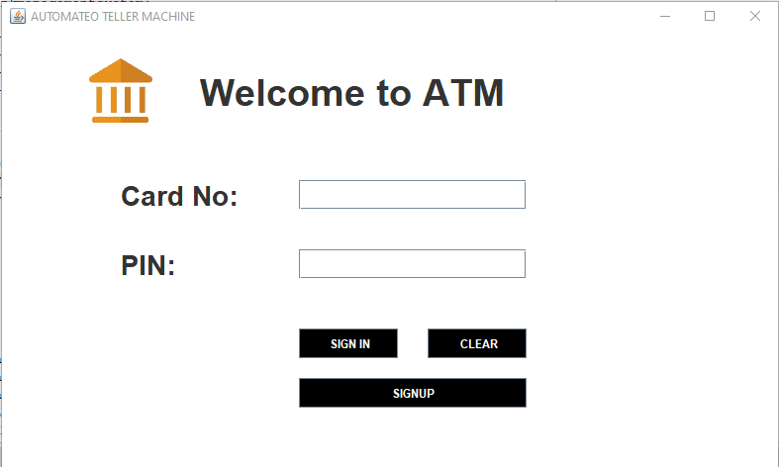
Login Page
User have to insert their card no and pin to access the system. All the data of the administrator is
already stored in the database.If the card no and pin of the user doesn’t match, the user can’t
access to the system that time they have to signup.

Slide 11
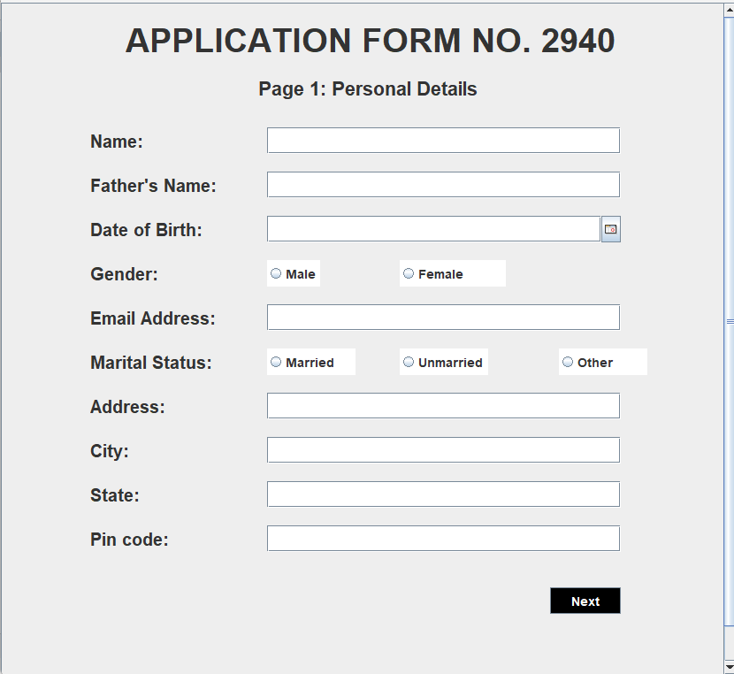
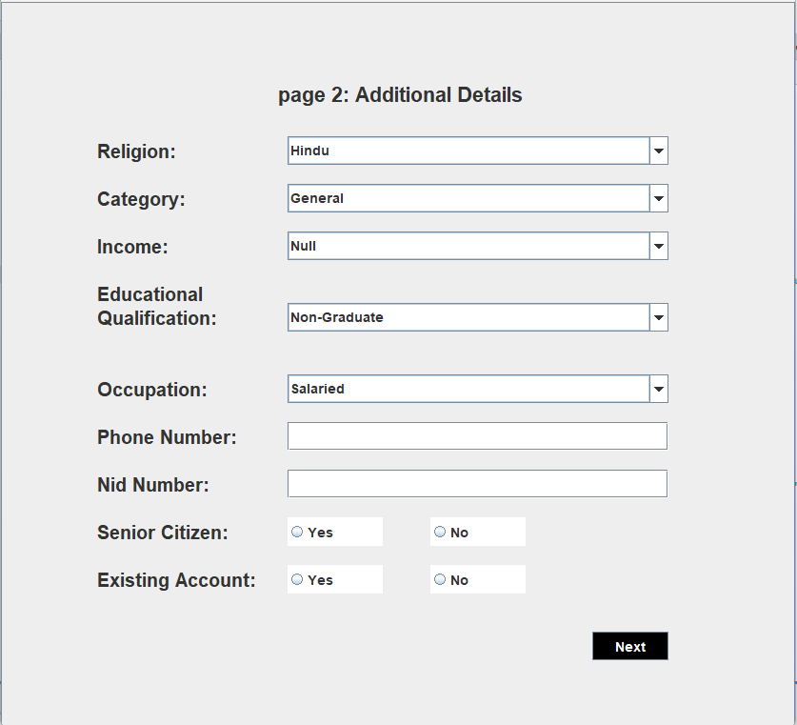
Sign Up page
The user needs to fill out all required fields in order to create a new account.

Slide 12
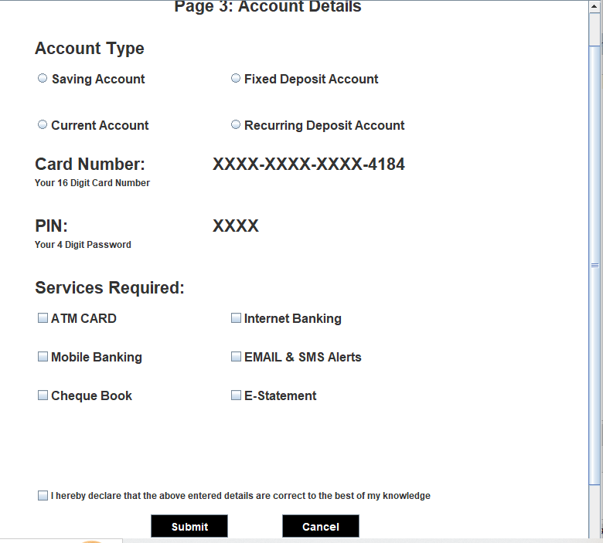
Account Details
The user can choose the type of account they want to create and the services they
wish to use. From this page, a user will receive a 16-digit card number and a 4-digit PIN

Slide 13
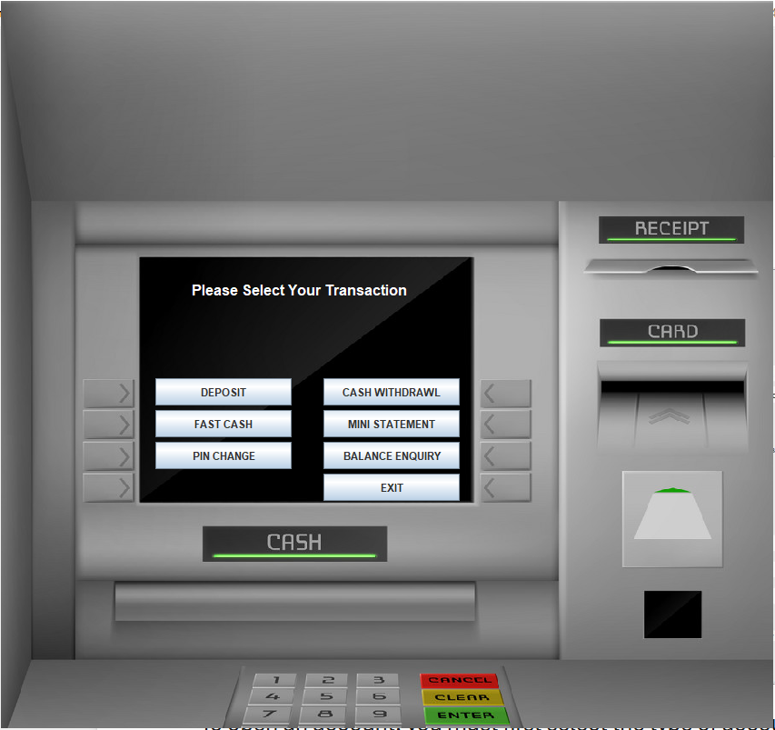
Transaction page
Through this page the user can deposit,
Withdraw, fast cash, pin change, balance check and get a mini statement.

Slide 14
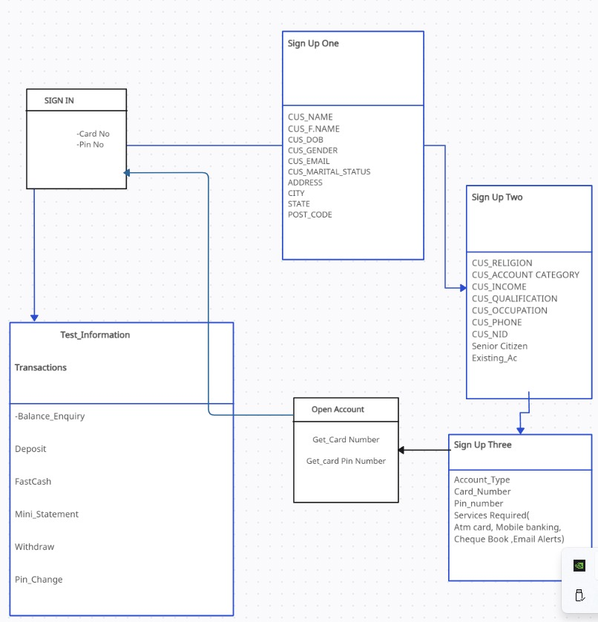
Database design

Slide 15
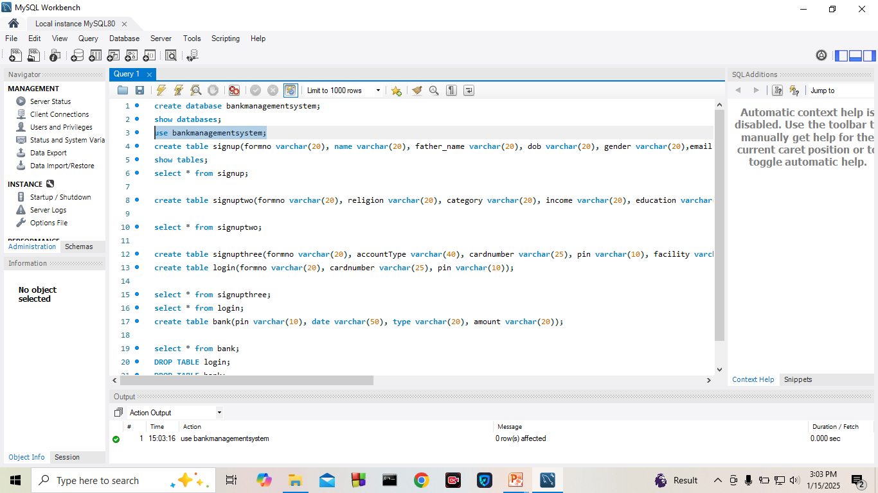
Database

Slide 16
Bank management
Account Exist?
yes
No
Verify
New account
Perform transaction
Perform
transaction
receipt

Slide 17
Conclusion
This project addresses the essential needs of users in the banking sector by
streamlining transactions like deposits, withdrawals, and account management. Future versions aim to introduce even more advanced features to enhance usability and efficiency. By integrating modern methods such as ATM and debit card transactions, the system keeps up with evolving banking technologies.

